Slide 1
Computer Organization

Slide 2
Computer Organization and Architecture
Computer Organization and Architecture is used to design computer systems
Computer Architecture is considered to be those attributes of a system that are visible to the user like addressing techniques, instruction sets, and bits used for data, and have a direct impact on the logic execution of a program, It defines the system in an abstract manner, It deals with What does the system do.
Computer Organization is the way in which a system has to structure and It is operational units and the interconnections between them that achieve the architectural specifications, It is the realization of the abstract model, and It deals with How to implement the system.

Slide 3
Computer Organization | Von Neumann architecture
Historically there have been 2 types of Computers:
Fixed Program Computers – Their function is very specific and they couldn’t be reprogrammed, e.g. Calculators.
Stored Program Computers – These can be programmed to carry out many different tasks, applications are stored on them, hence the name.

Slide 4
Modern computers are based on a stored-program concept introduced by John Von Neumann.
In this stored-program concept, programs and data are stored in a separate storage unit called memories and are treated the same
This novel idea meant that a computer built with this architecture would be much easier to reprogram.

Slide 5
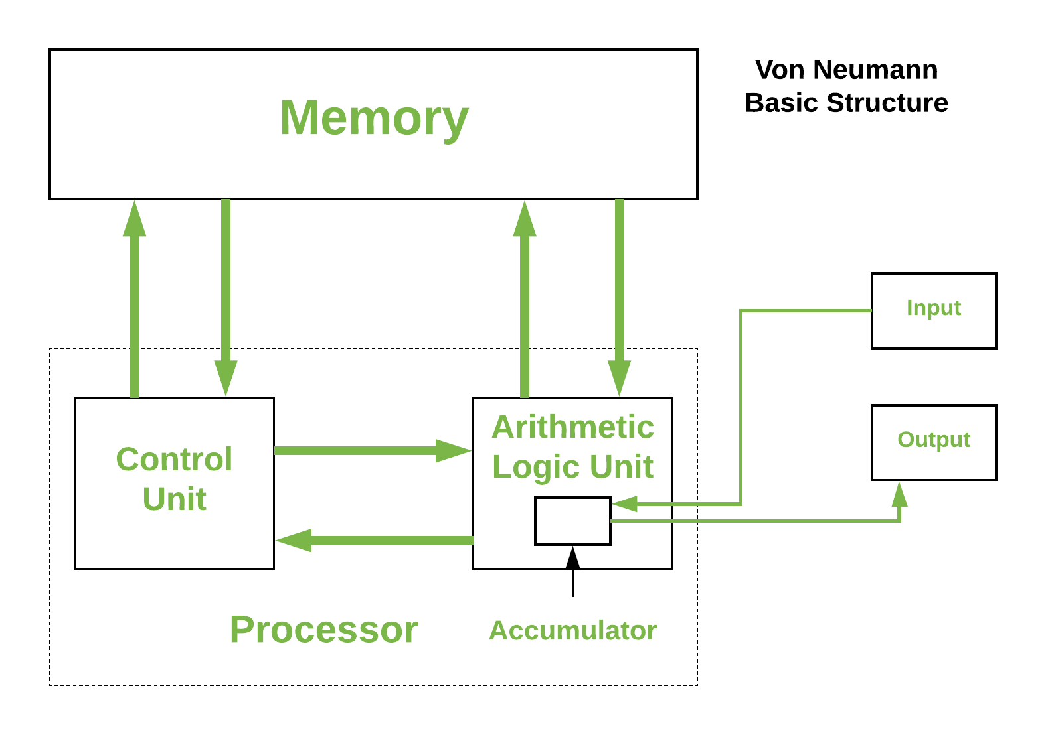

Slide 6
Computer structures: General register machine, Accumulator based machine, stack machines.
General Purpose Registers
A register serves as a quick memory for accepting, storing, and sending data and instructions that the CPU will need right away
A register is a collection of flip-flops, Single bit digital data is stored using flip-flops.
By combining many flip-flops, the storage capacity can be extended to accommodate a huge number of bits
We must utilize an n-bit register with n flip flops if we wish to store an n-bit word.

Slide 7
The gates govern the flow of information, i.e., when and how the information is sent into a register, whereas the flip-flops store the binary information.

Slide 8
Working of Registers:
When we provide the system with input, that input is stored in registers, and when the system returns results after processing, those results are also drawn from the registers. so that the CPU can use them to process the data that the user provides.

Slide 9
Registers are performed based on three operations:
Fetch: The Fetch Operation is used to retrieve user-provided instructions that have been stored in the main memory. Registers are used to fetch these instructions.
Decode: The Decode Operation is used to interpret the Instructions, which means that the CPU will determine which Operation has to be carried out on the Instructions after the Instructions have been decoded.
Execute: The CPU manages the Execute Operation. The results that the CPU generates are then stored in the memory before being presented on the user screen

Slide 10
Types of Registers:
Status and control registers.
General-purpose data registers.
Special purpose register.

Slide 11
Design of a shifter

Slide 12
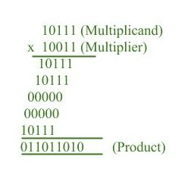
Multiplication Algorithm in Signed Magnitude Representation
Multiplication of two fixed point binary number in signed magnitude representation is done with process of successive shift and add operation.
In the multiplication process we are considering successive bits of the multiplier, least significant bit first. If the multiplier bit is 1, the multiplicand is copied down else 0’s are copied down.

Slide 13
The numbers copied down in successive lines are shifted one position to the left from the previous number.
Finally numbers are added and their sum form the product.
The sign of the product is determined from the sign of the multiplicand and multiplier. If they are alike, sign of the product is positive else negative.

Slide 14
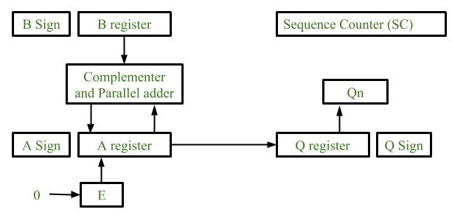
Hardware Implementation :

Slide 15
Registers: Two Registers B and Q are used to store multiplicand and multiplier respectively. Register A is used to store partial product during multiplication. Sequence Counter register (SC) is used to store number of bits in the multiplier.
Flip Flop: To store sign bit of registers we require three flip flops (A sign, B sign and Q sign). Flip flop E is used to store carry bit generated during partial product addition.
Complement and Parallel adder: This hardware unit is used in calculating partial product i.e, perform addition required

Slide 16
Initially multiplicand is stored in B register and multiplier is stored in Q register
Sign of registers B (Bs) and Q (Qs) are compared using XOR functionality (i.e., if both the signs are alike, output of XOR operation is 0 unless 1) and output stored in As (sign of A register).
Note: Initially 0 is assigned to register A and E flip flop. Sequence counter is initialized with value n, n is the number of bits in the Multiplier.

Slide 17
Now least significant bit of multiplier is checked. If it is 1 add the content of register A with Multiplicand (register B) and result is assigned in A register with carry bit in flip flop E. Content of E A Q is shifted to right by one position, i.e., content of E is shifted to most significant bit (MSB) of A and least significant bit of A is shifted to most significant bit of Q.
If Qn = 0, only shift right operation on content of E A Q is performed in a similar fashion.
Content of Sequence counter is decremented by 1.
Check the content of Sequence counter (SC), if it is 0, end the process and the final product is present in register A and Q, else repeat the process

Slide 18
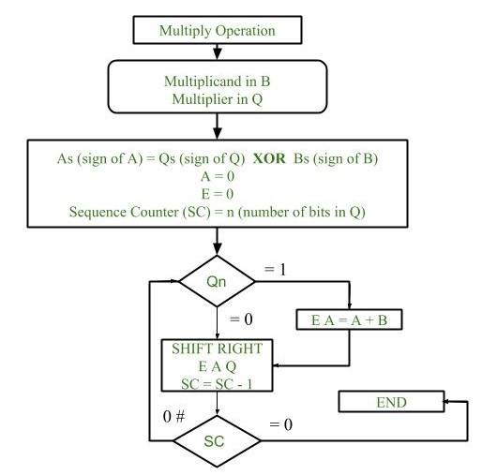
Flowchart of Multiplication:

Slide 19
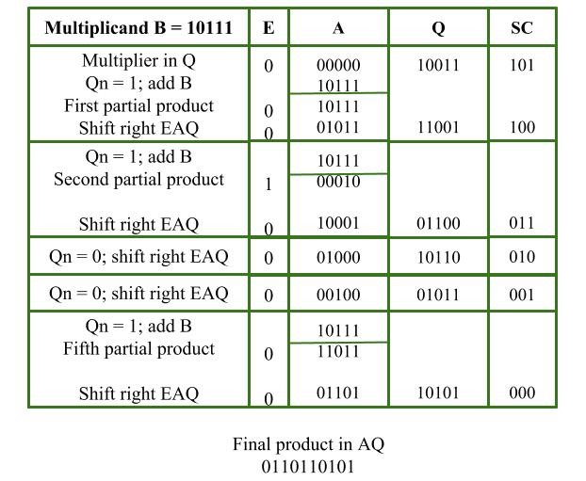
Example:

Slide 20
Booth’s Multiplication Algorithm
Booth’s algorithm is a multiplication algorithm that multiplies two signed binary numbers in 2’s complement notation.
Booth used desk calculators that were faster at shifting than adding and created the algorithm to increase their speed. Booth’s algorithm is of interest in the study of computer architecture. Here’s the implementation of the algorithm.

Slide 21
Algorithm :
Put multiplicand in BR and multiplier in Q and then the algorithm works as per the following conditions : 1. If Q_{n} and Q_{n+1} are same i.e. 00 or 11 perform arithmetic shift by 1 bit. 2. If Q_{n} Q_{n+1} = 01 do A= A +BR and perform arithmetic shift by 1 bit. 3. If Q_{n} Q_{n+1} = 10 do A= A – BR and perform arithmetic shift by 1 bit.

Slide 22
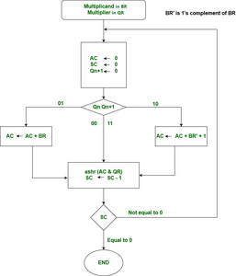

Slide 23
BR = -5 = 1011, BR' = 0100, <-- 1's Complement (change the values 0 to 1 and 1 to 0)
BR'+1 = 0101 <-- 2's Complement (add 1 to the Binary value obtained after 1's complement)
QR = -7 = 1001 <-- 2's Complement of 0111 (7 = 0111 in Binary)
The explanation of first step is as follows:
Qn+1 AC = 0000, QR = 1001, Qn+1 = 0, SC = 4
Qn Qn+1 = 10
So, we do AC + (BR)'+1, which gives AC = 0101 On right shifting AC and QR,
we get AC = 0010, QR = 1100 and Qn+1 = 1

Slide 24
OPERATION | AC | QR | Qn+1 | SC
 | 0000 | 1001 | 0 | 4
AC + BR’ + 1 | 0101 | 1001 | 0
ASHR | 0010 | 1100 | 1 | 3
AC + BR | 1101 | 1100 | 1
ASHR | 1110 | 1110 | 0 | 2
ASHR | 1111 | 0111 | 0 | 1
AC + BR’ + 1 | 0100 | 0111 | 0
ASHR | 0010 | 0011 | 1 | 0

Slide 25
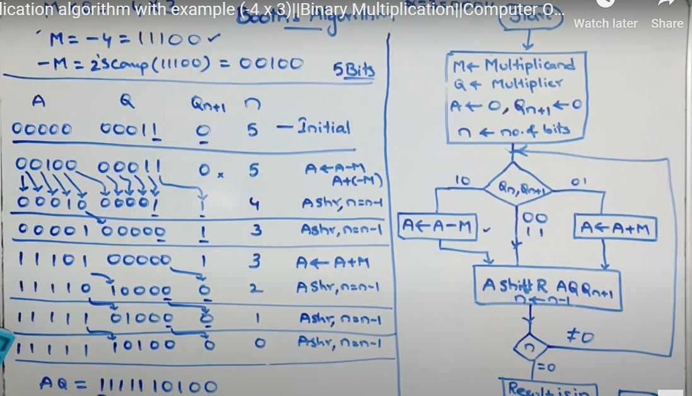

Slide 26
Booth algorithm gives a procedure for multiplying binary integers in signed 2’s complement representation in efficient way, i.e., less number of additions/subtractions required
Prior to the shifting, the multiplicand may be added to the partial product, subtracted from the partial product, or left unchanged according to following rules:
The multiplicand is subtracted from the partial product upon encountering the first least significant 1 in a string of 1’s in the multiplier
The multiplicand is added to the partial product upon encountering the first 0 (provided that there was a previous ‘1’) in a string of 0’s in the multiplier.
The partial product does not change when the multiplier bit is identical to the previous multiplier bit.

Slide 27
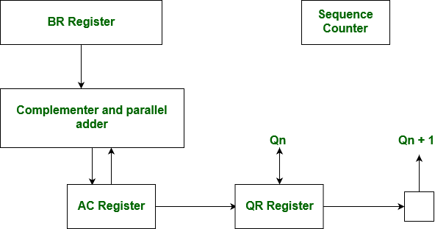
Hardware Implementation of Booths Algorithm
The hardware implementation of the booth algorithm requires the register configuration shown in the figure below.

Slide 28
Advantages:
Faster than traditional multiplication: Booth’s algorithm is faster than traditional multiplication methods, requiring fewer steps to produce the same result.
Efficient for signed numbers: The algorithm is designed specifically for multiplying signed binary numbers, making it a more efficient method for multiplication of signed numbers than traditional methods.
Lower hardware requirement: The algorithm requires fewer hardware resources than traditional multiplication methods, making it more suitable for applications with limited hardware resources.
Widely used in hardware: Booth’s algorithm is widely used in hardware implementations of multiplication operations, including digital signal processors, microprocessors, and FPGAs.

Slide 29
Disadvantages:
Complex to understand: The algorithm is more complex to understand and implement than traditional multiplication methods.
Limited applicability: The algorithm is only applicable for multiplication of signed binary numbers, and cannot be used for multiplication of unsigned numbers or numbers in other formats without additional modifications.
Higher latency: The algorithm requires multiple iterations to calculate the result of a single multiplication operation, which increases the latency or delay in the calculation of the result.
Higher power consumption: The algorithm consumes more power compared to traditional multiplication methods, especially for larger inputs.
Best Case and Worst Case Occurrence: Best case is when there is a large block of consecutive 1’s and 0’s in the multipliers, so that there is minimum number of logical operations taking place, as in addition and subtraction. Worst case is when there are pairs of alternate 0’s and 1’s, either 01 or 10 in the multipliers, so that maximum number of additions and subtractions are required. GATE Practice

Slide 30
Division algorithms
They are generally of two type slow algorithm and fast algorithm. Slow division algorithm are restoring, non-restoring, non-performing restoring, SRT algorithm
under fast comes Newton–Raphson and Goldschmidt.

Slide 31
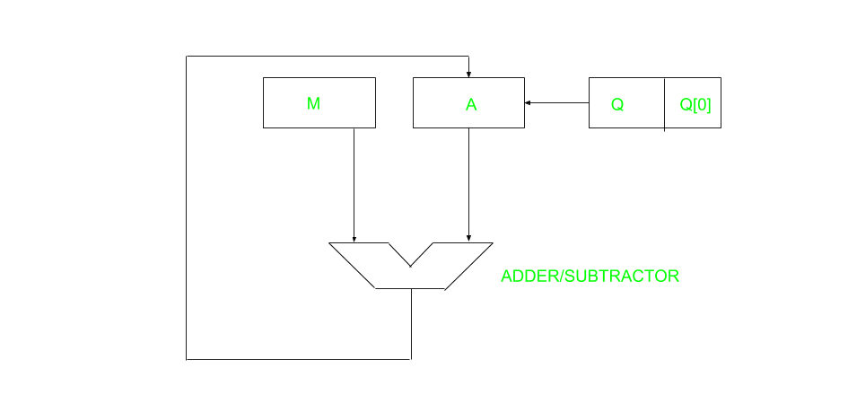
restoring algorithm for unsigned integer.
Restoring term is due to fact that value of register A is restored after each iteration.

Slide 32
register Q contain quotient and register A contain remainder.
Here, n-bit dividend is loaded in Q and divisor is loaded in M.
Value of Register is initially kept 0 and this is the register whose value is restored during iteration due to which it is named Restoring.

Slide 33
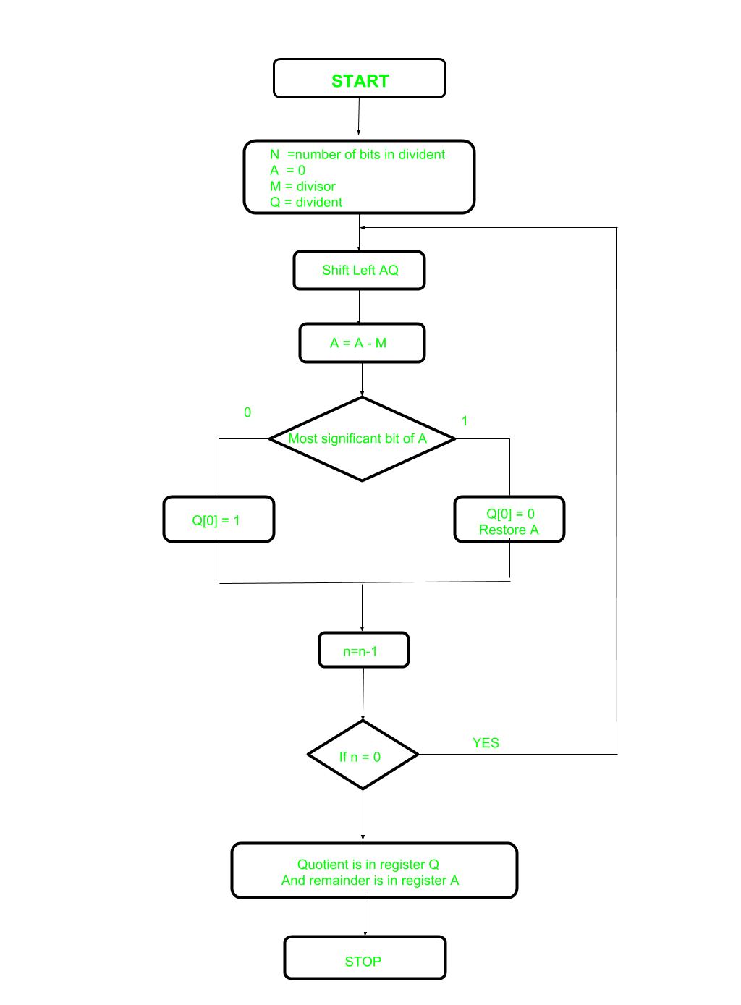

Slide 34
Step-1: First the registers are initialized with corresponding values (Q = Dividend, M = Divisor, A = 0, n = number of bits in dividend)
Step-2: Then the content of register A and Q is shifted left as if they are a single unit
Step-3: Then content of register M is subtracted from A and result is stored in A
Step-4: Then the most significant bit of the A is checked if it is 0 the least significant bit of Q is set to 1 otherwise if it is 1 the least significant bit of Q is set to 0 and value of register A is restored i.e the value of A before the subtraction with M
Step-5: The value of counter n is decremented
Step-6: If the value of n becomes zero we get of the loop otherwise we repeat from step 2
Step-7: Finally, the register Q contain the quotient and A contain remainder

Slide 35
Perform Division Restoring Algorithm Dividend = 11 Divisor = 3
n | M | A | Q | Operation
4 | 00011 | 00000 | 1011 | initialize
 | 00011 | 00001 | 011_ | shift left AQ
 | 00011 | 11110 | 011_ | A=A-M
 | 00011 | 00001 | 0110 | Q[0]=0 And restore A
3 | 00011 | 00010 | 110_ | shift left AQ
 | 00011 | 11111 | 110_ | A=A-M
 | 00011 | 00010 | 1100 | Q[0]=0
2 | 00011 | 00101 | 100_ | shift left AQ
 | 00011 | 00010 | 100_ | A=A-M
 | 00011 | 00010 | 1001 | Q[0]=1
1 | 00011 | 00101 | 001_ | shift left AQ
 | 00011 | 00010 | 001_ | A=A-M
 | 00011 | 00010 | 0011 | Q[0]=1

Slide 36
Non-Restoring Division For Unsigned Integer
it is less complex than the restoring one because simpler operation are involved i.e. addition and subtraction, also no restoring step is performed.
In the method, rely on the sign bit of the register which initially contain zero named as A.

Slide 37
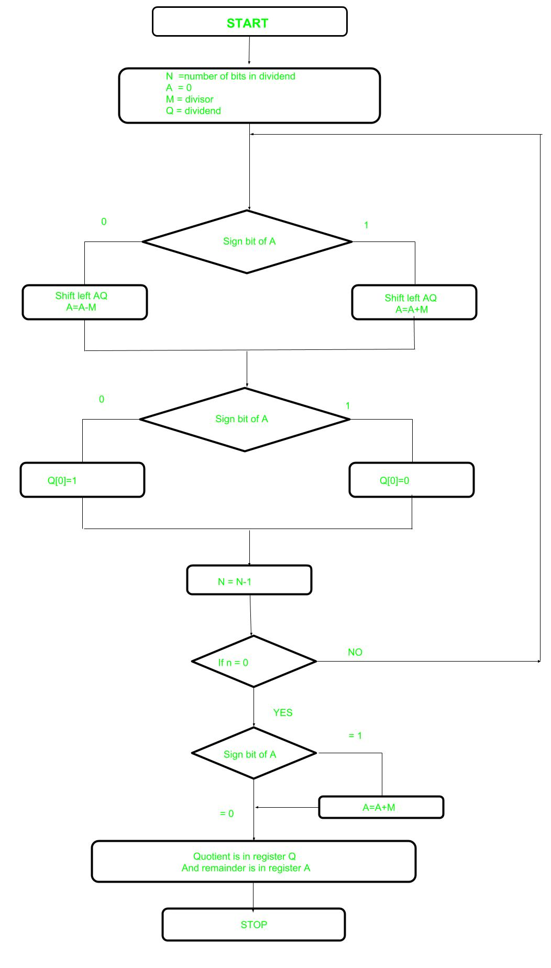

Slide 38
Step-1: First the registers are initialized with corresponding values (Q = Dividend, M = Divisor, A = 0, n = number of bits in dividend)
Step-2: Check the sign bit of register A
Step-3: If it is 1 shift left content of AQ and perform A = A+M, otherwise shift left AQ and perform A = A-M (means add 2’s complement of M to A and store it to A)
Step-4: Again the sign bit of register A
Step-5: If sign bit is 1 Q[0] become 0 otherwise Q[0] become 1 (Q[0] means least significant bit of register Q)
Step-6: Decrements value of N by 1
Step-7: If N is not equal to zero go to Step 2 otherwise go to next step
Step-8: If sign bit of A is 1 then perform A = A+M
Step-9: Register Q contains quotient and A contains remainder.

Slide 39
Introduction of ALU
Representing and storing numbers were the basic operation of the computers of earlier times.
The real go came when computation, manipulating numbers like adding, multiplying came into the picture.
These operations are handled by the computer’s arithmetic logic unit (ALU).
The ALU is a digital circuit that provides arithmetic and logic operations.
It is the fundamental building block of the central processing unit of a computer.
A modern CPU has a very powerful ALU and it is complex in design.
In addition to ALU modern CPU contains a control unit and a set of registers.

Slide 40
Most of the operations are performed by one or more ALU’s, which load data from the input register.
Registers are a small amount of storage available to the CPU. These registers can be accessed very fast. The control unit tells ALU what operation to perform on the available data.
After calculation/manipulation, the ALU stores the output in an output register.

Slide 41
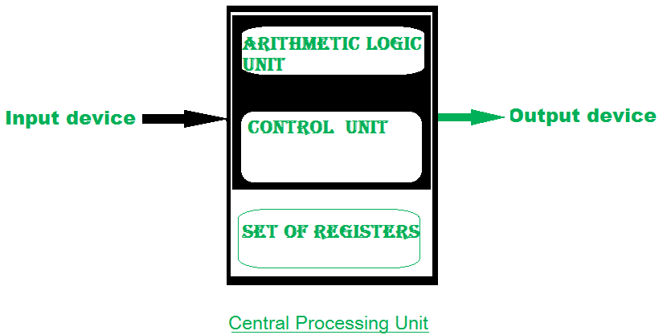

Slide 42
The CPU can be divided into two sections: the data section and the control section. The DATA section is also known as the data path.
BUS: In early computers “BUS” were parallel electrical wires with multiple hardware connections. Therefore a bus is a communication system that transfers data between components inside a computer, or between computers.
It includes hardware components like wires, optical fibers, etc and software, including communication protocols.
The Registers, ALU, and the interconnecting BUS are collectively referred to as data paths.

Slide 43
Types of the bus are:
Address bus: The buses which are used to carry address.
Data bus: The buses which are used to carry data.
Control bus: If the bus is carrying control signals.
Power bus: If it is carrying clock pulse, power signals it is known as a power bus, and so on.

Slide 44
Program Counter – A program counter (PC) is a CPU register in the computer processor which has the address of the next instruction to be executed from memory. As each instruction gets fetched, the program counter increases its stored value by 1. It is a digital counter needed for faster execution of tasks as well as for tracking the current execution point.
Instruction Register – In computing, an instruction register (IR) is the part of a CPU’s control unit that holds the instruction currently being executed or decoded. The instruction register specifically holds the instruction and provides it to the instruction decoder circuit.

Slide 45
Memory Address Register – The Memory Address Register (MAR) is the CPU register that either stores the memory address from which data will be fetched from the CPU, or the address to which data will be sent and stored. It is a temporary storage component in the CPU(central processing unit) that temporarily stores the address (location) of the data sent by the memory unit until the instruction for the particular data is executed.
Memory Data Register – The memory data register (MDR) is the register in a computer’s processor, or central processing unit, CPU, that stores the data being transferred to and from the immediate access storage. Memory data register (MDR) is also known as memory buffer register (MBR).

Slide 46
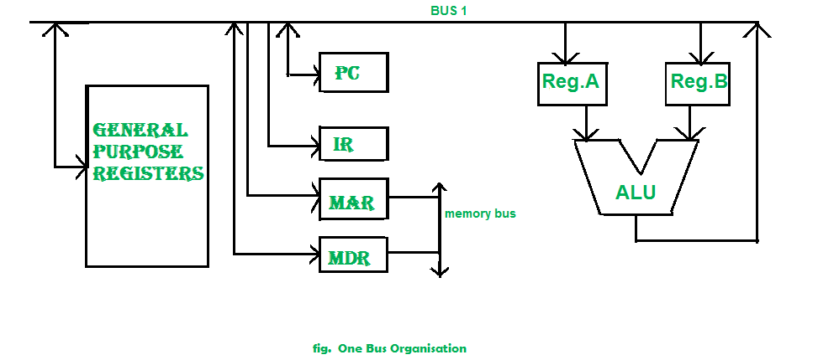
General Purpose Register – General-purpose registers are used to store temporary data within the microprocessor. It is a multipurpose register. They can be used either by a programmer or by a user.

